Slide 1
Event Handling
Events and Event Handlers | React Event Parameters | Passing Arguments to Event Handlers
Notes:
Welcome to our lecture on event handling. In this lecture we will go through events and event handlers, event parameters in react, and how to pass argument to event handlers. Let’s start the video lecture.

Slide 2

Events and Event Handlers
A React event is an action triggered by the user, like a click, key press, or form submission.
An event handler is a function that responds to an event, specified using the "on" prefix in camel case (e.g., onClick, onKeyDown).
React events are similar to DOM events but follow a synthetic event system for cross-browser consistency.
Notes:
A React event is any user interaction, like a click, key press, or form submission. To handle these events, we use event handlers, which are functions that respond to the action. React event handlers use the prefix "on" in camel case, such as onClick or onKeyDown. Unlike traditional DOM events, React uses a synthetic event system, ensuring consistency across different browsers.

Slide 3
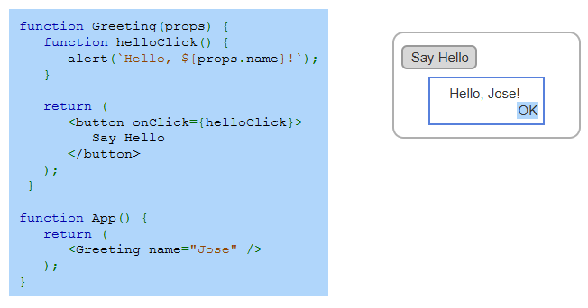
Example
Notes:
Now, let’s look at an example of handling events in React. The Greeting component receives a name as a prop and includes a button with an on Click event handler. When the button is clicked, the hello Click function runs, displaying an alert with a personalized greeting. The App component renders Greeting with the name Jose. Clicking the button triggers the alert saying Hello Jose.

Slide 4
React Event Parameter
A React event parameter is an optional argument passed to an event handler, providing details about the event.
It contains properties like event.target, which refers to the element that triggered the event.
React events use a SyntheticEvent wrapper for better performance and cross-browser compatibility.
Notes:
Next, let's explore the React event parameter. This parameter is an optional argument passed to an event handler, providing useful details about the event. It includes properties like event target, which identifies the element that triggered the event. Additionally, React events use a Synthetic Event wrapper, ensuring better performance and cross-browser compatibility when handling user interactions.

Slide 5
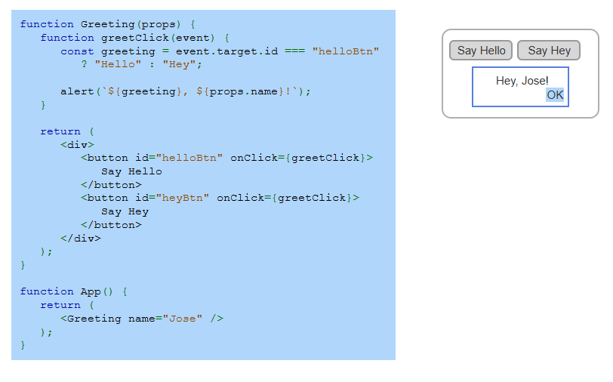
Example
Notes:
Now, let’s examine this example using the event parameter. The Greeting component has a greet Click function that checks which button was clicked using event target id. If the button has an id of hello Btn, it displays Hello, otherwise, it shows Hey. When a button is clicked, an alert appears with the corresponding greeting and the user's name. The App component renders Greeting with the name Jose.

Slide 6
Passing Arguments to Event Handlers
Arguments can be passed to an event handler using an arrow function inside the event attribute.
This allows different buttons or elements to call the same function with different arguments.
Example: <button onClick={() => greetClick("Hello")}>Say Hello</button> calls greetClick("Hello") when clicked.
Notes:
Next, let's discuss passing arguments to event handlers. In React, arguments can be passed to an event handler using an arrow function inside the event attribute. This approach allows multiple elements to call the same function with different arguments. For example, a button with on Click set to an arrow function can call greet Click with Hello as an argument, ensuring flexibility in handling user interactions.

Slide 7
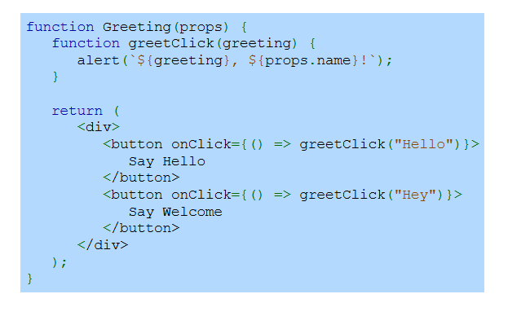
Example
Notes:
Now, let’s look at an example of passing arguments to event handlers. The Greeting component has a greet Click function that takes a greeting as an argument. Two buttons call this function using arrow functions inside on Click. The first button passes Hello, while the second button passes Hey. When clicked, an alert displays the greeting along with the user's name, demonstrating how different arguments can be used dynamically.

